Slide 1
Introduction to Number Systems

Slide 2
Non-Positional Number System
A non-positional number system uses a limited number of symbols in which each symbol has a value.
However the position a symbol occupies in the number normally bears no relation to its value.
The value of each symbol is fixed.

Slide 3
Non-Positional Number System
Roman number system is an example of a non-positional number system.
This number system has a set of symbols.
S={I, V, X, L, C, D, M}.
Values of symbols in the Roman number system.
Symbol I V X L C D M
Value 1 5 10 50 100 500 1000

Slide 4
Positional Number System
A positional (numeral) system is a system for representation of numbers by an ordered set of numerals symbols (called digits) in which the value of a numeral symbol depends on its position.
For each position a unique symbol or a limited set of symbols is used.

Slide 5
Positional Number System
Each symbol represents different value depending on the position they occupy in a number.
The value of a symbol is given by the weight of its position expressed in the bases (or radices) of the system.

Slide 6
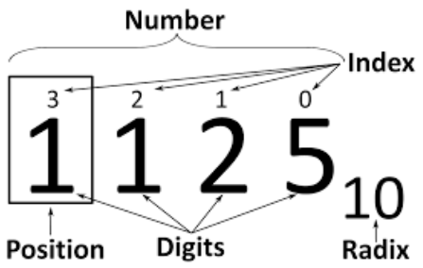
Positional Number System – Terminologies

Slide 7
Decimal Number System
The decimal number system is an example of positional number system because the value of the number depends on the position of the digits.
For example, the number 12345 has a very different value than the number 54321, although the same digits are used in both numbers.

Slide 8
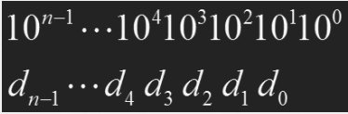
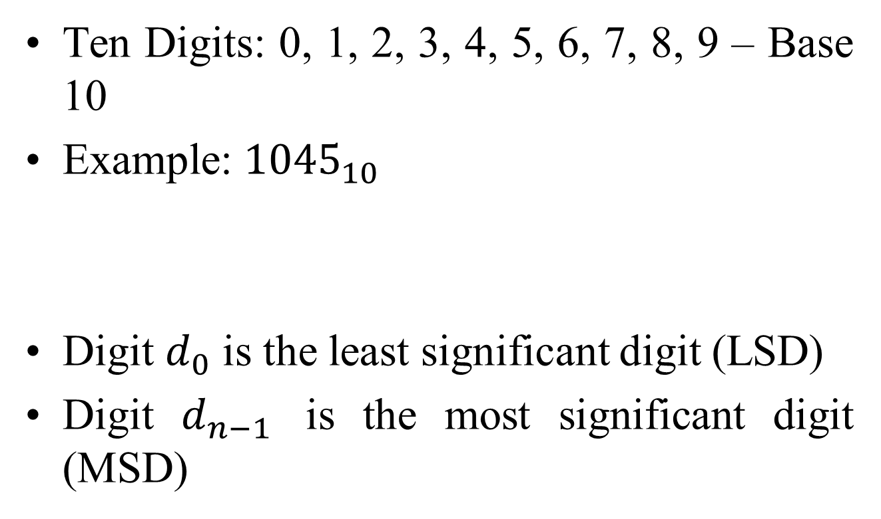
Decimal Number System
Ten Digits: 0, 1, 2, 3, 4, 5, 6, 7, 8, 9 – Base 10
Example: ${1045}_{10}$
Digit $d_{0}$ is the least significant digit (LSD)
Digit $d_{n−1}$ is the most significant digit (MSD)

Slide 9
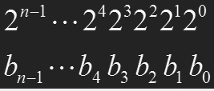
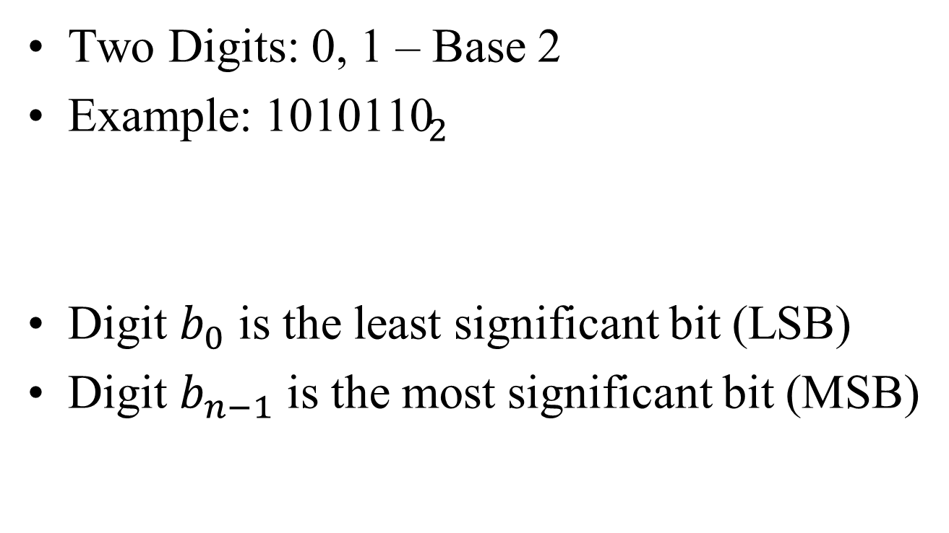
Binary Number System
Two Digits: 0, 1 – Base 2
Example: ${\text{1010110}}_{2}$
Digit $b_{0}$ is the least significant bit (LSB)
Digit $b_{n−1}$ is the most significant bit (MSB)

Slide 10
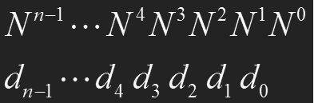
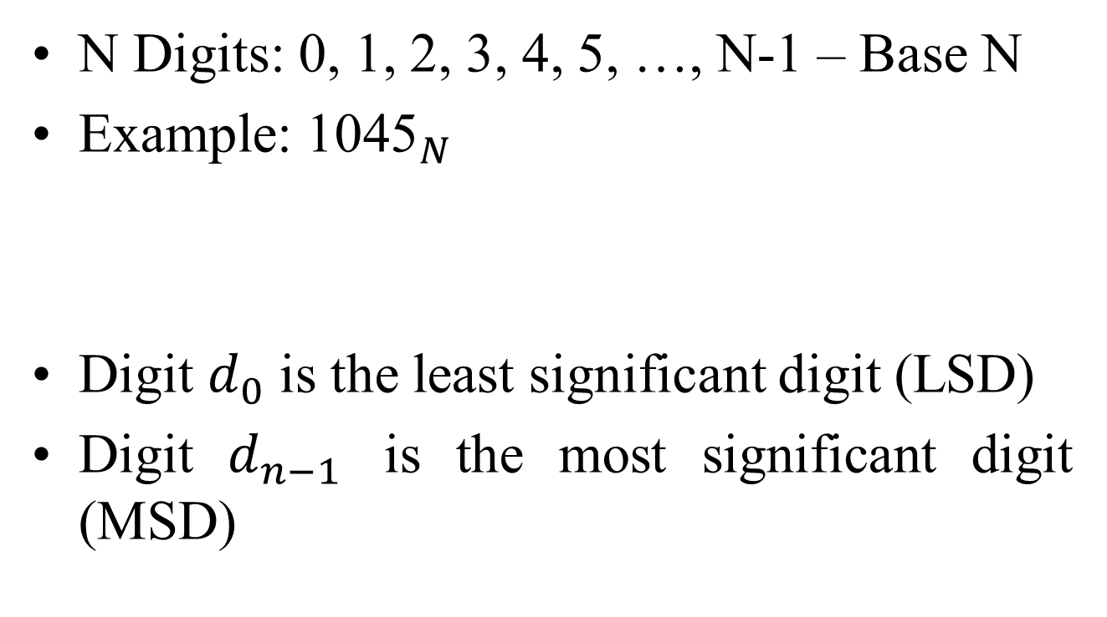
Base-N Number System
N Digits: 0, 1, 2, 3, 4, 5, …, N-1 – Base N
Example: ${\text{10}\text{45}}_{N}$
Digit $d_{0}$ is the least significant digit (LSD)
Digit $d_{n−1}$ is the most significant digit (MSD)

Slide 11
Number Systems
Four number system
Decimal (10)
Binary (2)
Octal (8)
Hexadecimal (16)
............

Slide 12
Binary numbers?
Computers work only on two states
On
Off
Basic memory elements hold only two states
Zero / One
Thus a number system with two elements {0,1}
A binary digit – bit !

Slide 13
Decimal numbers
1439 = 1 x 10³ + 4 x 10² + 3 x 10¹ + 9 x 10⁰
Thousands Hundreds Tens Ones
Radix = 10

Slide 14
Binary Decimal
1101 = 1 x 2³ + 1 x 2² + 0 x 2¹ + 1 x 2⁰
= 1 x 8 + 1 x 4 + 0 x 2 + 1 x 1
= 8 + 4 + 0 + 1
(1101)₂ = (13)₁₀
1, 2, 4, 8, 16, 32, 64, 128, 256, 512, ….

Slide 15
Decimal Binary
2
13
1
LSB
2
6
0
2
3
1
2
1
1
MSB
0
(13)₁₀ = (1101)₂

Slide 16
Octal Decimal
137 = 1 x 8² + 3 x 8¹ + 7 x 8⁰
= 1 x 64 + 3 x 8 + 7 x 1
= 64 + 24 + 7
(137)₈ = (95)₁₀
Digits used in Octal number system – 0 to 7 so 108 will not be part of it as 8 is out of range.

Slide 17
Decimal Octal
8
95
7
LSP
8
11
3
8
1
1
0
MSP
(95)₁₀ = (137)₈

Slide 18
Hex Decimal
BAD = 11 x 16² + 10 x 16¹ + 13 x 16⁰
= 11 x 256 + 10 x 16 + 13 x 1
= 2816 + 160 + 13
(BAD)₁₆ = (2989)₁₀
A = 10, B = 11, C = 12, D = 13, E = 14, F = 15

Slide 19
Decimal Hex
16
2989
13
LSP
16
186
10
16
11
11
0
MSP
(2989)₁₀ = (BAD)₁₆

Slide 20
Why octal or hex?
Ease of use and conversion
Three bits make one octal digit
111 010 110 101
7 2 6 5 => 7265 in octal
Four bits make one hexadecimal digit
1110 1011 0101
E B 5 => EB5 in hex
4 bits = nibble

Slide 21
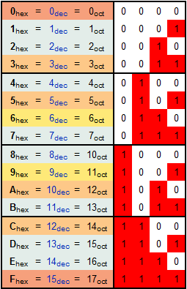

Slide 22
Negative numbers
Three representations
Signed magnitude
1’s complement
2’s complement

Slide 23
Sign magnitude
Make MSB represent sign
Positive = 0
Negative = 1
E.g. for a 3 bit set
“-2”
Sign | Bit | Bit
1 | 1 | 0
MSB |  | LSB

Slide 24
1’s complement
MSB as in sign magnitude
Complement all the other bits
Given a positive number complement all bits to get negative equivalent
E.g. for a 3 bit set
“-2”
Sign | Bit | Bit
1 | 0 | 1
0 | 1 | 0

Slide 25
2’s complement
1’s complement plus one
E.g. for a 3 bit set
“-2”
Sign | Bit | Bit
1 | 1 | 0
0 | 1 | 0

Slide 26
Decimal number | Signed magnitude | 2’s complement | 1’s complement
3 | 011 | 011 | 011
2 | 010 | 010 | 010
1 | 001 | 001 | 001
0 | 000 | 000 | 000
-0 | 100 | --- | 111
-1 | 101 | 111 | 110
-2 | 110 | 110 | 101
-3 | 111 | 101 | 100
-4 |  | 100
No matter which scheme is used we get an even set of numbers but we need one less (odd: as we have a unique zero)

Slide 27
Binary Arithmetic
Addition / subtraction
Unsigned
Signed
Using negative numbers

Slide 28
Unsigned: Addition
Like normal decimal addition
B
A
The carry out of the MSB is neglected
+ | 0 | 1
0 | 0 | 1
1 | 1 | 10
0101 (5)
+ 1001 (9)
1110 (14)

Slide 29
Unsigned: Subtraction
Like normal decimal subtraction
B
A
A borrow (shown in red) from the MSB implies a negative
- | 0 | 1
0 | 0 | 11
1 | 1 | 0
1001 (9)
- 0101 (5)
0100 (4)

Slide 30
Signed arithmetic
Use a negative number representation scheme
Reduces subtraction to addition

Slide 31
2’s complement
Negative numbers in 2’s complement
001 ( 1)₁₀
101 (-3)₁₀
110 (-2)₁₀
The carry out of the MSB is lost

Slide 32
Overflow / Underflow
Maximum value N bits can hold : 2^{n} –1
When addition result is bigger than the biggest number of bits can hold.
Overflow
When addition result is smaller than the smallest number the bits can hold.
Underflow
Addition of a positive and a negative number cannot give an overflow or underflow.

Slide 33
Overflow example
011 (+3)₁₀
011 (+3)₁₀
110 (+6)₁₀ ????
1’s complement computer interprets it as –1 !!
(+6)₁₀ = (0110)₂ requires four bits !

Slide 34
Underflow examples
Two’s complement addition
101 (-3)₁₀
101 (-3)₁₀
Carry 1 010 (-6)₁₀ ????
The computer sees it as +2.
(-6)₁₀ = (1010)₂ again requires four bits !

